Slide 1
Geo/Spatial Search with MySQL
Alexander Rubin
Senior Consultant, MySQL AB

Slide 2
Why Geo Search?
Stores: find locations new you
Social networks: find friends close to you
Online maps: find points of interest near your position
Online newspapers/yellow pages: find show times next to you home.

Slide 3
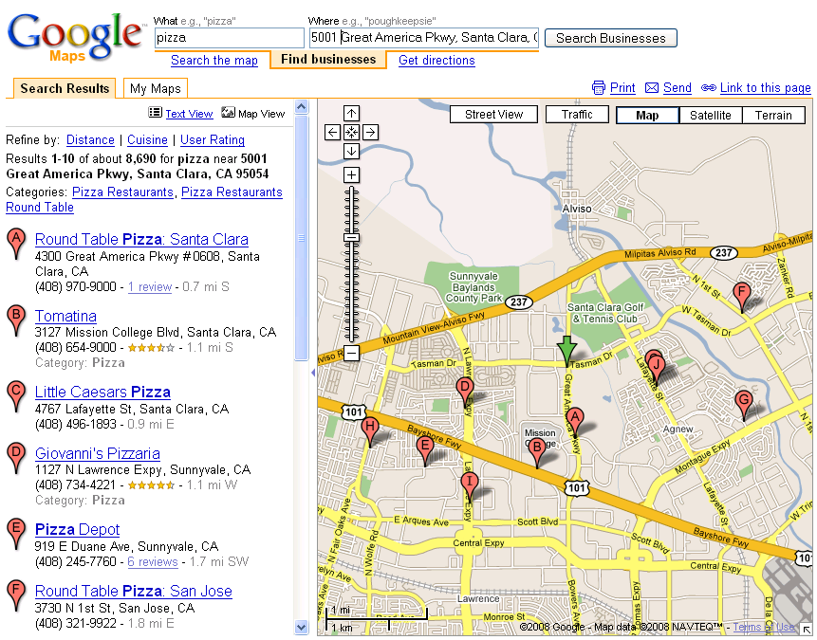
POI Search Example

Slide 4
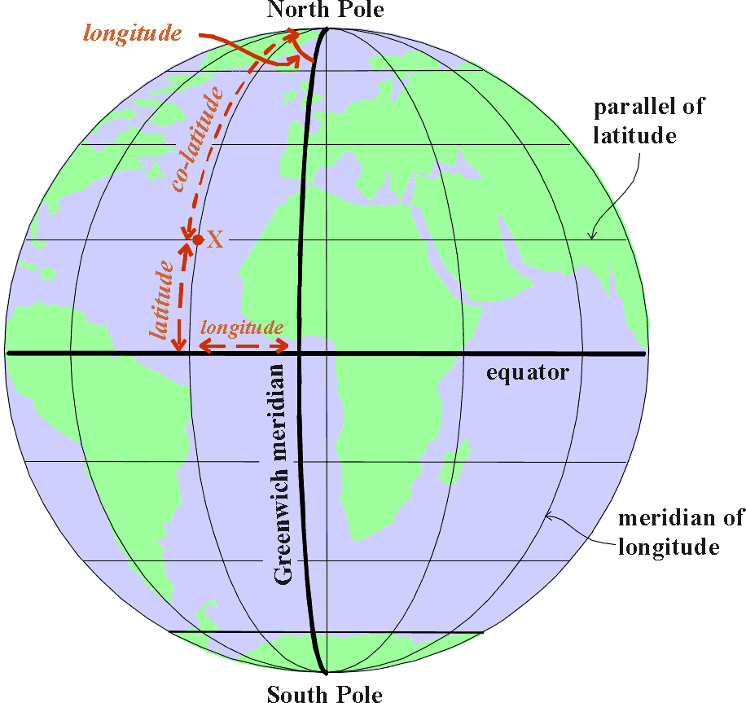
Common Tasks
Task: Find 10 nearby hotels
and sort by distance
What do we have:
  Given point on Earth: Latitude, Longitude
  Hotels table:
Question: How to calculate distance between us and hotel?
Hotel Name | Latitude | Longitude

Slide 5
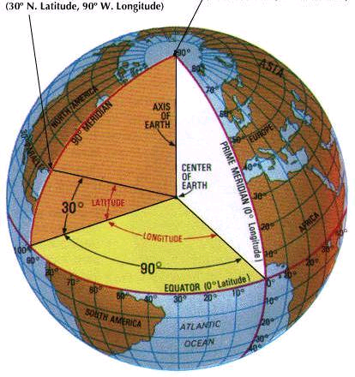
Latitudes and Longitudes

Slide 6


Distance between 2 points
The Haversine Formula
For two points on a sphere (of radius R) with latitudes φ1 and φ2, latitude separation Δφ = φ1 − φ2, and longitude separation Δλ the distance d between the two points:

Slide 7
The Haversine Formula in MySQL
R = earth’s radius
Δlat = lat2− lat1; Δlong = long2− long1
a = sin²(Δlat/2) + cos(lat1) * cos(lat2) * sin²(Δlong/2)
c = 2*atan2(√a, √(1−a)); d = R*c
3956 * 2 * ASIN ( SQRT (
POWER(SIN((orig.lat - dest.lat)*pi()/180 / 2), 2) + COS(orig.lat * pi()/180) * COS(dest.lat * pi()/180) * POWER(SIN((orig.lon - dest.lon) * pi()/180 / 2), 2) ) ) as distance
angles need to be in radians

Slide 8
MySQL Query: Find Nearby Hotels
set @orig_lat=122.4058; set @orig_lon=37.7907;
set @dist=10;
SELECT *, 3956 * 2 * ASIN(SQRT(
POWER(SIN((@orig_lat - abs(dest.lat)) * pi()/180 / 2), 2) + COS(@orig_lat * pi()/180 ) * COS(abs(dest.lat) * pi()/180) * POWER(SIN((@orig_lon – dest.lon) * pi()/180 / 2), 2) )) as distance
FROM hotels dest
having distance < @dist
ORDER BY distance limit 10;
Lat can be negative!

Slide 9
Find Nearby Hotels: Results
+----------------+--------+-------+--------+
| hotel_name | lat | lon | dist |
+----------------+--------+-------+--------+
| Hotel Astori.. | 122.41 | 37.79 | 0.0054 |
| Juliana Hote.. | 122.41 | 37.79 | 0.0069 |
| Orchard Gard.. | 122.41 | 37.79 | 0.0345 |
| Orchard Gard.. | 122.41 | 37.79 | 0.0345 |
...
+----------------+--------+-------+--------+
10 rows in set (4.10 sec)
4 seconds - very slow for web query!

Slide 10
MySQL Explain query
Mysql> Explain …
select_type: SIMPLE
table: dest
type: ALL
possible_keys: NULL
key: NULL
key_len: NULL
ref: NULL
rows: 1787219
Extra: Using filesort
1 row in set (0.00 sec)

Slide 11
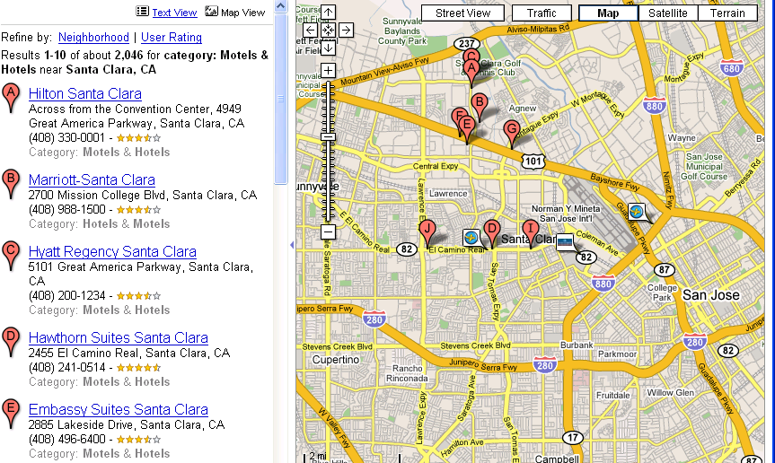
How to speed up the query
We only need hotels in 10 miles radius
  no need to scan the whole table
10 Miles

Slide 12
How to calculate needed coordinates
1° of latitude ~= 69 miles
1° of longitude ~= cos(latitude)*69
To calculate lon and lat for the rectangle:
set lon1 = mylon-dist/abs(cos(radians(mylat))*69);
set lon2 = mylon+dist/abs(cos(radians(mylat))*69);
set lat1 = mylat-(dist/69);
set lat2 = mylat+(dist/69);

Slide 13
Modify the query
SELECT destination.*,
3956 * 2 * ASIN(SQRT( POWER(SIN((orig.lat - dest.lat) * pi()/180 / 2), 2) +
COS(orig.lat * pi()/180) * COS(dest.lat * pi()/180) * POWER(SIN((orig.lon -dest.lon) * pi()/180 / 2), 2) )) as
distance
FROM users destination, users origin
WHERE origin.id=userid
and destination.longitude
between lon1 and lon2
and destination.latitude
between lat1 and lat2

Slide 14
Stored procedure
CREATE PROCEDURE geodist (IN userid int, IN dist int) BEGIN
declare mylon double; declare mylat double;
declare lon1 float; declare lon2 float;
declare lat1 float; declare lat2 float;
-- get the original lon and lat for the userid
select longitude, latitude into mylon, mylat from users5 where id=userid limit 1;
-- calculate lon and lat for the rectangle:
set lon1 = mylon-dist/abs(cos(radians(mylat))*69);
set lon2 = mylon+dist/abs(cos(radians(mylat))*69);
set lat1 = mylat-(dist/69); set lat2 = mylat+(dist/69);

Slide 15
Stored Procedure, Contd
-- run the query:
SELECT destination.*,
3956 * 2 * ASIN(SQRT( POWER(SIN((orig.lat - dest.lat) * pi()/180 / 2), 2) +
COS(orig.lat * pi()/180) * COS(dest.lat * pi()/180) * POWER(SIN((orig.lon -dest.lon) * pi()/180 / 2), 2) )) as
distance FROM users destination, users origin WHERE origin.id=userid
and destination.longitude between lon1 and lon2
and destination.latitude between lat1 and lat2
having distance < dist ORDER BY Distance limit 10;
END $$

Slide 16
Speed comparison
Test data: US and Canada zip code table, 800K records
Original query (full table scan):
  8 seconds
Optimized query (stored procedure):
  0.06 to 1.2 seconds (depending upon the number of POIs/records in the given radius)

Slide 17
Stored Procedure: Explain Plan
Mysql>CALL geodist(946842, 10)\G
table: origin
type: const
key: PRIMARY
key_len: 4
ref: const
rows: 1, Extra: Using filesort
table: destination
type: range
key: latitude
key_len: 18
ref: NULL
rows: 25877, Extra: Using where
Notes:
ADD EXPLAIN PLAN

Slide 18
Geo Search with Sphinx
Sphinx search (www.sphinxsearch.com) since 0.9.8 can perform geo distance searches
It is possible to setup an "anchor point" in the api code and then use the "geodist" function and specify the radius.
Sphinx Search returns in 0.55 seconds for test data regardless of the radius and zip
$ php test.php -i zipdist -s @geodist,asc Query '' retrieved 1000 matches in 0.552 sec.

Slide 19
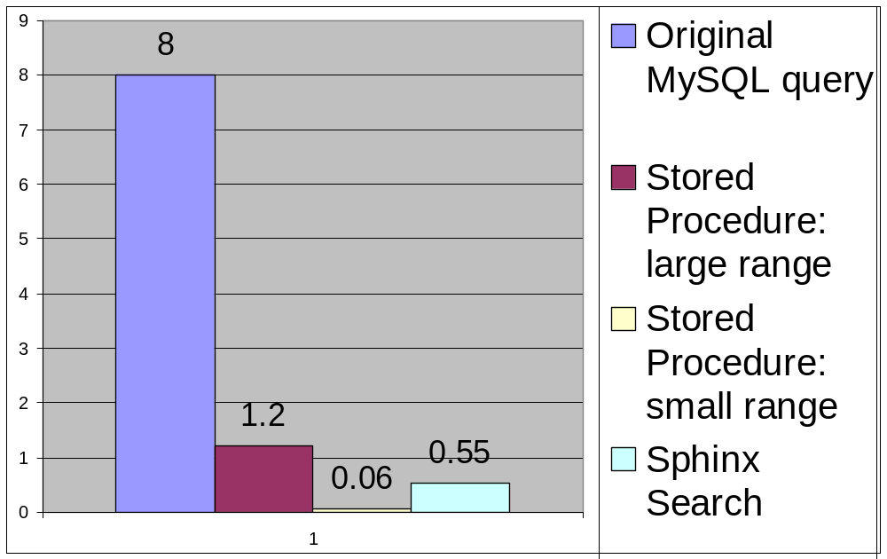
Speed comparison of all solutions

Slide 20
Different Type of Coordinates
Decimal Degrees (what we used)
  37.3248 LAT, 121.9163 LON
Degrees-minutes-second (used in most GPSes)
  37°19′29″N LAT, 121°54′59″E LON
Most GPSes can be configured to use Decimal Degrees
Other

Slide 21
Converting between coordinates
Degrees-Minutes-Seconds to Decimal Degrees:
  degrees + (minutes/60) + (seconds/3600)
CREATE FUNCTION `convert_from_dms`
(degrees INT, minutes int, seconds int)
RETURNS double DETERMINISTIC
BEGIN
RETURN degrees + (minutes/60) + (seconds/3600);
END $$
mysql>select convert_from_dms (46, 20, 10) as DMS\G
dms: 46.33611111

Slide 22
Geo Search with Full Text search
Sometimes we need BOTH geo search and full text search
Example 1: find 10 nearest POIs, with “school” in the name
Example 2: find nearest streets, name contains “OAK”
Create FullText index and index on LAT, LON
  Alter table geonames add fulltext key (name);
  MySQL will choose which index to use

Slide 23
Geo Search with Full Text search: example
Grab POI data from www.geonames.org, upload it to MySQL, add full text index
Mysql> SELECT destination.*,
3956 * 2 * ASIN(SQRT(POWER(SIN((orig.lat - dest.lat) * pi()/180 / 2), 2) + COS(orig.lat * pi()/180) * COS(dest.lat * pi()/180) * POWER(SIN((orig.lon -dest.lon) * pi()/180 / 2), 2) )) as distance
FROM geonames destination
WHERE match(name)
against (‘OAK’ in boolean mode)
having distance < dist ORDER BY Distance limit 10;

Slide 24
Geo Search with Full Text search: Explain
mysql> explain SELECT destination.*,
3956 * 2 * ASIN(SQRT(POWER(SIN(…
table: destination
type: fulltext
possible_keys: name_fulltext
key: name_fulltext
key_len: 0
ref:
rows: 1
Extra: Using where; Using filesort
Notes:
ADD EXPLAIN PLAN

Slide 25
DEMO
DEMO: Find POI near us
  Use GPS
  All POIs near GPS point
  Match keyword

Slide 26
Using MySQL Spatial Extension
CREATE TABLE `zipcode_spatial` (
`id` int(10) unsigned NOT NULL AUTO_INCREMENT,
`zipcode` char(7) NOT NULL, …
`lon` int(11) DEFAULT NULL,
`lat` int(11) DEFAULT NULL,
`loc` point NOT NULL,
PRIMARY KEY (`id`),
KEY `zipcode` (`zipcode`),
SPATIAL KEY `loc` (`loc`)
) ENGINE=MyISAM;

Slide 27
Zipcode with Spatial Extension
mysql> select zipcode, lat, lon, AsText(loc) from zipcode_spatial where city_name = 'Santa Clara' and state ='CA' limit 1\G
****** 1. row********
zipcode: 95050
lat: 373519
lon: 1219520
AsText(loc): POINT(1219520 373519)

Slide 28
Spatial Search: Distance
Spatial Extension: no built-in distance function
CREATE FUNCTION `distance`
(a POINT, b POINT)
RETURNS double DETERMINISTIC
BEGIN
RETURN round(glength(linestringfromwkb
(linestring(asbinary(a), asbinary(b)))));
END $$
(forge.mysql.com/tools/tool.php?id=41)

Slide 29
Spatial Search Example
SELECT DISTINCT
dest.zipcode,
distance(orig.loc, dest.loc) as sdistance
FROM
zipcode_spatial orig,
zipcode_spatial dest
WHERE
orig.zipcode = '27712'
having sdistance < 10
ORDER BY
sdistance limit 10;

